Slide 1



//Developers_Institute_
TLV Coding Bootcamp
LinkedIn Workshop
Developers Institute ranked #31 in SwitchUp's Best Coding Bootcamps Worldwide
México 🇲🇽 - Cameroon 🇨🇲 - Senegal 🇸🇳 - Burkina Faso 🇧🇫 - Mali 🇲🇱 - Ghana 🇬🇭 - Togo 🇹🇬 - Mauritius 🇲🇺 - Israël 🇮🇱

Slide 2

What is
?
Linkedin is the world's largest professional network on the internet
You can use LinkedIn
To find the right job or internship
To connect and strengthen professional relationships
To learn the skills you need in order to succeed in your career

Slide 3
Why
?
94% of recruiters
use LinkedIn to find candidates.
Notes:
Why are we focusing on LinkedIn today?
Because it’s one of the most use tools that the recruiter looks at in order to check your career path + It’s a for recruiter to find candidates

Slide 4
Get your profile to 100%
Completed profile ranks higher in the internal algorithm, meaning you’re more likely to be discovered. (Like Google’s search engine, LinkedIn relies on an algorithm when displaying search results)
Here’s what makes your LinkedIn profile an all-star profile:
Profile picture + Cover picture
Your headline - Position
Location and industry
Experience
Skills
Education
At least 50 connections per week, preferably +500
Make sure your LinkedIn is in ENGLISH
LinkedIn makes it easy to reach a 100% completed profile by giving hints and recommendations along the way.
Profile Tips

Slide 5

Profile picture and Cover
Smiley at the camera and chest in the frame
Photo that looks like you
Use a high-resolution image
picture
No selfie
Make sure your face takes up at least 60% of the frame
Be the only person in the picture
Add a cover photo - from your company or field

Slide 6
Keywords are really important
Keywords matter a lot on LinkedIn because of the search algorithm that hiring managers and recruiters use to source talent.
To make sure the algorithm sends the right people your way, emphasize the specific things you want to work with, such as particular languages and frameworks. (Example: SWIFT, Python, PHP, SQL, WordPress, etc.)
At the same time, make sure to remove skills and technologies you are not interested in working with. Or at least de-emphasize them.

Slide 7
Summary
The summary section is your only chance to freely write on LinkedIn. It’s your chance to tell your story and describe what motivates you. (But don’t just write “I’m very motivated”)
Show examples of how you are motivated, e.g. “After discovering my passion for web development, I couldn’t get enough. I made websites for friends and family, interned with a local business, and hired myself out as a freelancer. I’m looking forward to bringing that passion to a full-time role.”
Moreover, include technologies and languages you want to work with.
Write in first person — like you are talking to a person, explaining what you do.
Finally, make sure your summary is 40+ words (it will be indexed better in the internal search results on LinkedIn)

Slide 8
8 steps to follow for a great LinkedIn Summary
Tell the story of your Career
Be Authentic
Touch on your accomplishments and successes
Use numbers
Articulate your unique value proposition -> What set you aparts from the competition
Transmit your key skills and experience
Optimize your summary with keywords
End with a clear call action

Slide 9
Highlight transferable skills
If you’re a newer developer, your tech skills may not be all there yet. If that’s the case, make sure to highlight any skills that may transfer from your current and previous non-tech positions.
Below are five transferable skills, which are valued in any role:
Communication skills, which can include writing, negotiating, presenting, and teaching/mentoring.
Teamwork or collaboration. Show you know this by mentioning collaboration tools you’ve used, give examples of ways you’ve worked with clients or teams, etc.
Planning and organization skills mean you are organized in thought, communication, and workflow. Demonstrate this by showing processes you’ve developed.
Ability to manage multiple responsibilities means you can multitask without getting stressed, rank your priorities, and stay disciplined.
Problem-solving skills means you can troubleshoot issues in new ways.
Always note software/tools you are familiar with, such Slack, Excel, Project,trello, Xcode, etc.

Slide 10
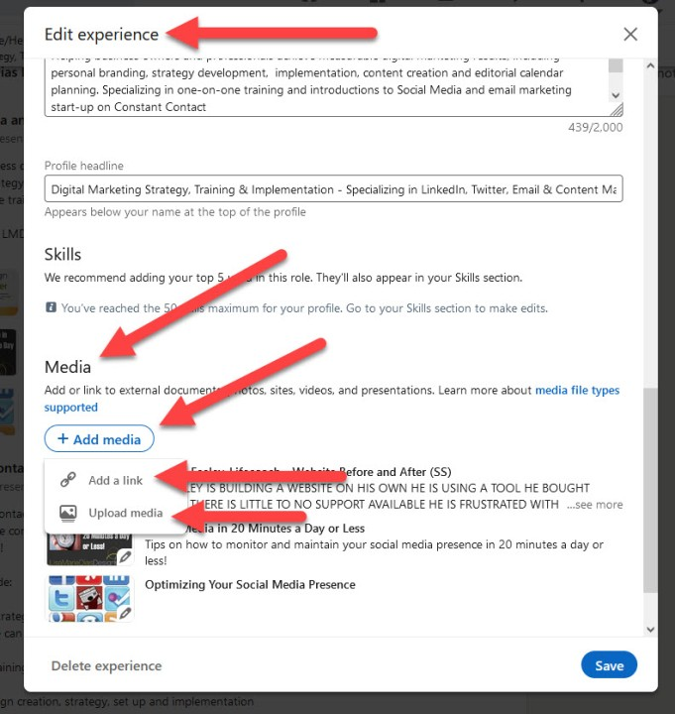
Show examples of your work
This is especially important if you don’t have a lot of experience to show yet. By showing work, you are substantiating your stated skills and experience.
One way you can do this by adding media to the summary, experience, and/or education sections. On LinkedIn you can add documents, photos, links, videos, and presentations.
Another way you can provide evidence of your skills is by including links to your portfolio, Github, CodePen, or blog.

Slide 11
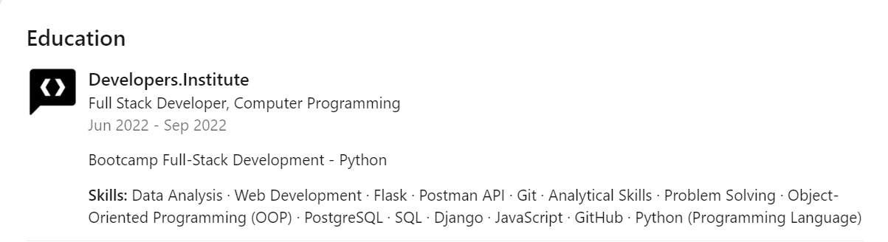
Include your education
The education section is especially important because it shows that you’ve studied and been tested on your tech knowledge. It also shows you value self-improvement.
Plus, people who fill out their education section receive 10 times more profile views than those who leave it blank.

Slide 12
Developers Institute - Education
Developers.Institute is a selective & intensive coding bootcamp, dedicated to educating the next generation of tech talent.
We offer cutting-edge mentored courses in Web Development, working with the industry’s best professionals to create the most that promise to take you from beginner to job-ready developer.
Notes:
We offer cutting-edge mentored courses in Web and mobile Development, working with the industry’s best professionals to create the most that promise to take you from beginner to job-ready developer in 3 months.

Slide 13
Don’t forget to add your Skills!
You can add up to 50 skills in your profile in the skill section - use them!
Those skills are important when the Recruiters will search for specific skills for specific jobs!
You can add everything you know. Remember that all the skills that you add here are keywords

Slide 14
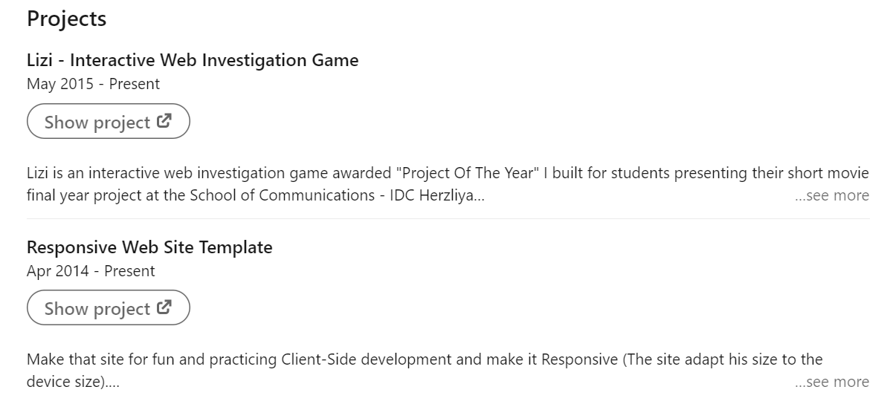
Don’t Forget to add your Projects!

Slide 15
How to get contacts on
?
Identify target companies and Connect with recruiters/Hr professionals/ Talent Acquisition and R&D members
Add people you know and also barely know
Alumni Networks
Attend networking events and job fairs

Slide 16
How to approach someone on LinkedIn?

Slide 17
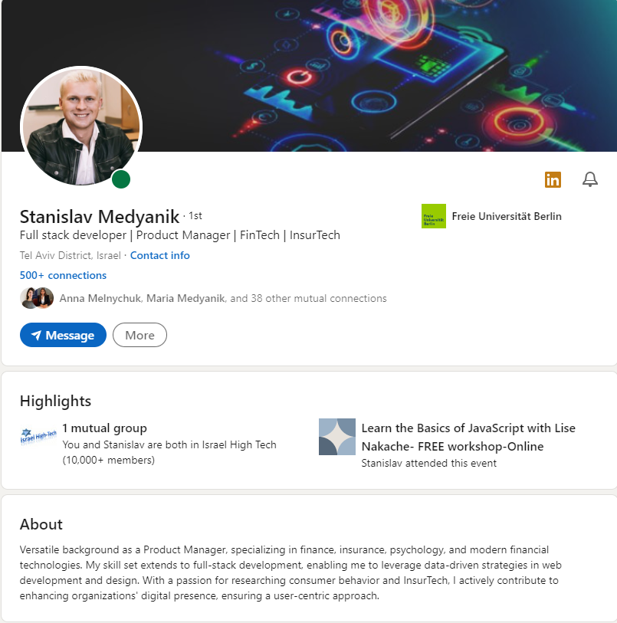
Example of LinkedIn Profile
Link to the profile

Slide 18

Be Careful….How do you want to appear as it relates to your “Professional Brand”?
Employers DO Look!!!!

Slide 19
Your next actions:
You have from now 2 weeks to finalize your LinkedIn profile
Add your video projects on LinkedIn via the media file
Complete the checklist
Be ACTIVE on LinkedIn!!!! And post minimum 3 posts per week, you can use daily.dev to get useful article

Slide 20

Thank you

Slide 21
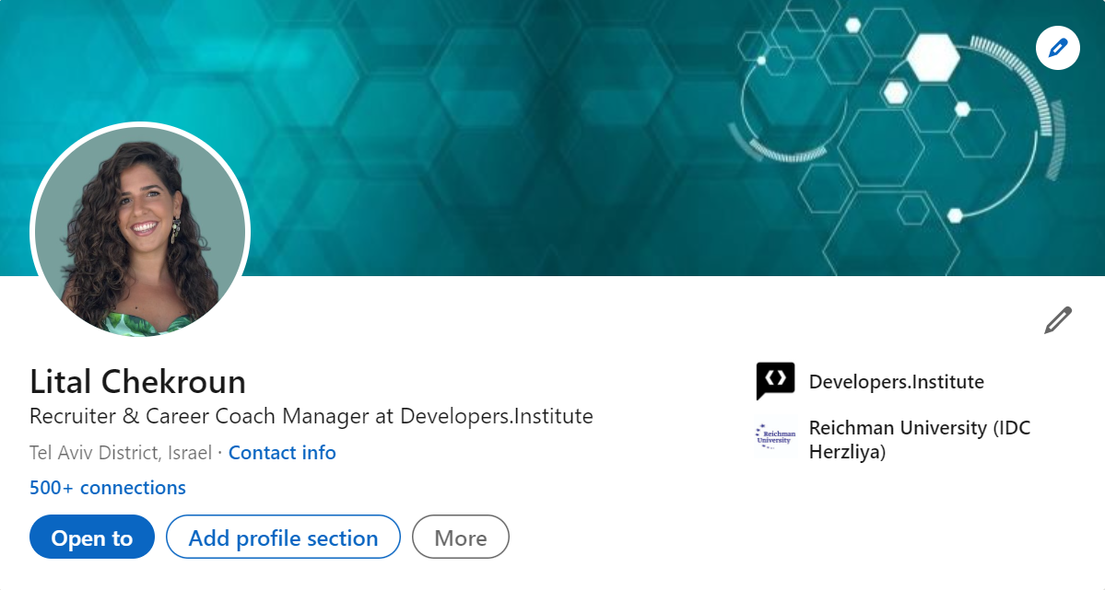
Hi, I am Lital Chekroun
Add me on LinkedIn!!

